Slide 1

E-Connect4 C++ Implementation
Group A&C
Using Visual Studio Code
&
WinBGIm graphic library

Slide 2

TABLE OF CONTENTS
1. Inspiration
2. Mission
3. Code Implementation
4. Run Demonstration

Slide 3

Inspiration

Slide 4
Inspiration
In the discussion, we found that the Connect 4 game combines logical and strategic elements, making it a very interesting game.
However, the traditional Connect 4 game requires purchasing a physical board and only supports PvP gameplay.
Therefore, we decided to implement the Connect 4 game in C++, allowing players to enjoy it without a physical board and enabling human-vs-computer gameplay.

Slide 5
Mission

Slide 6
Mission
Our mission is to design and develop a fully interactive and visually engaging Connect 4 game that demonstrates core principles of object-oriented programming (OOP).
This project aims to provide an intuitive user experience while showcasing essential OOP concepts like inheritance, encapsulation, composition, and polymorphism through a graphical interface

Slide 7
Code implementation

Slide 8
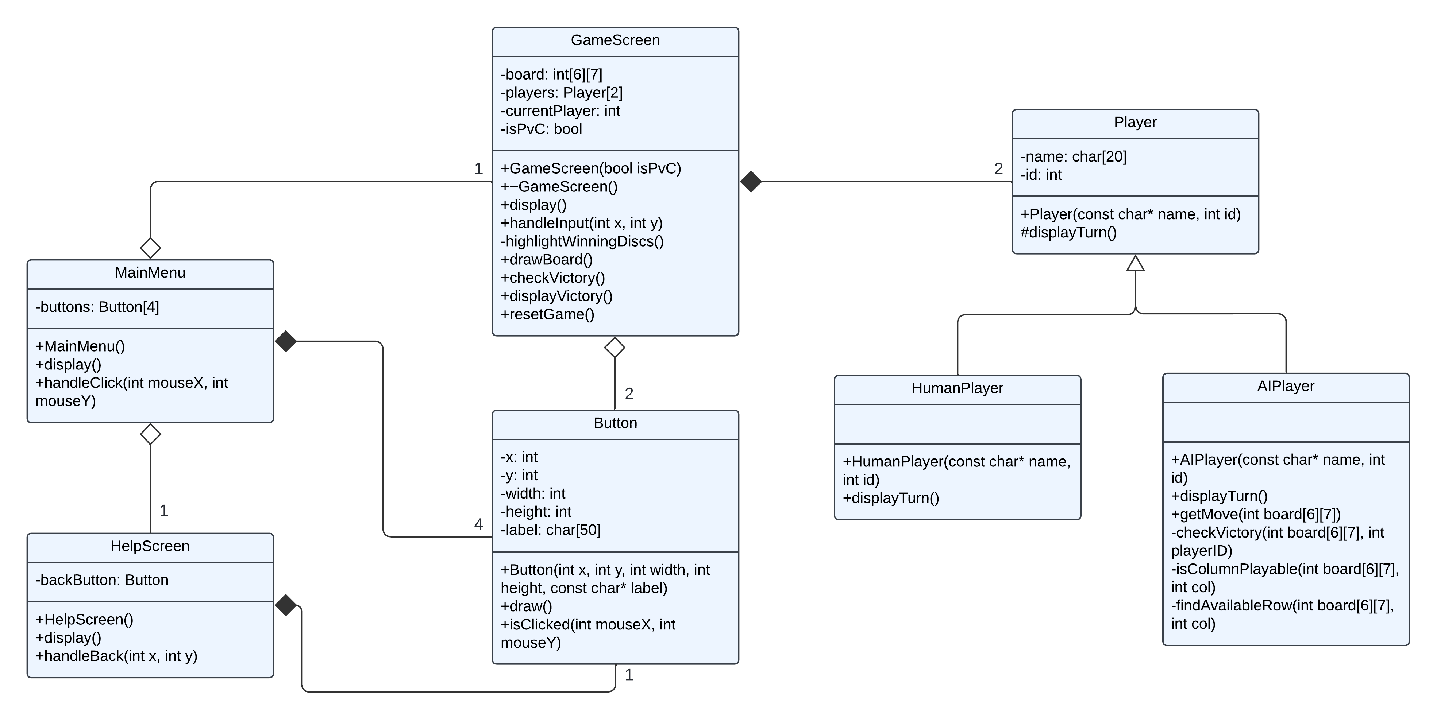
Class diagram

Slide 9
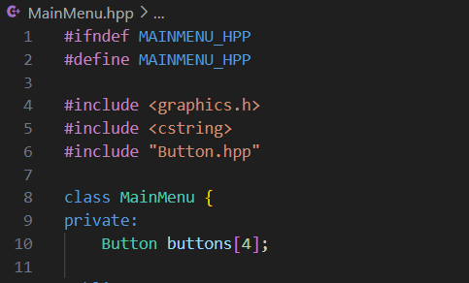
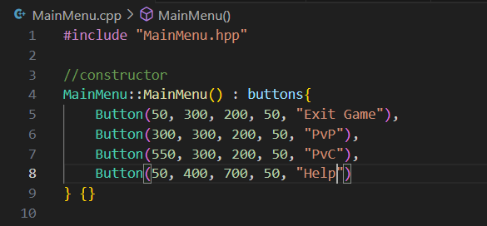
Array of objects
In MainMenu.hpp
In MainMenu.cpp

Slide 10
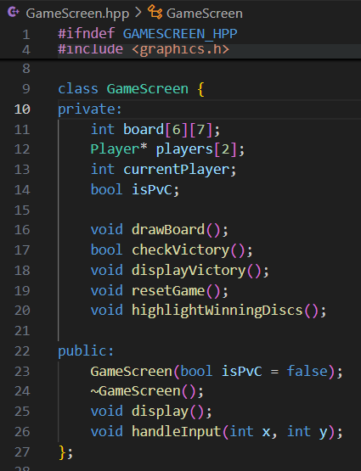
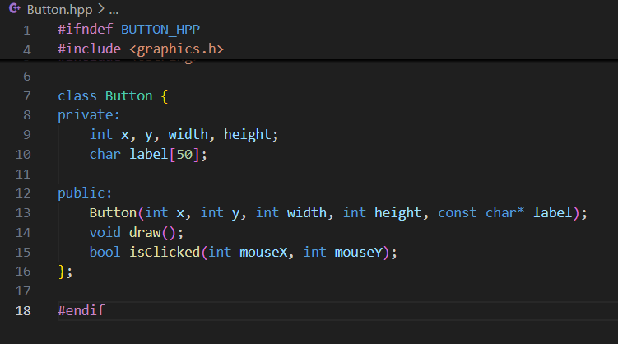
Encapsulation
In GameScreen.hpp
Private members only accessible through public methods
In Button.hpp

Slide 11
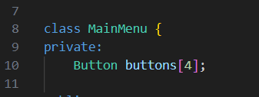

Composition
Lifecycles of these buttons are fully controlled by MainMenu/HelpScreen
In MainMenu.hpp
The 4 buttons are parts of MainMenu
In HelpScreen.hpp
The backButton is a part of MainMenu

Slide 12
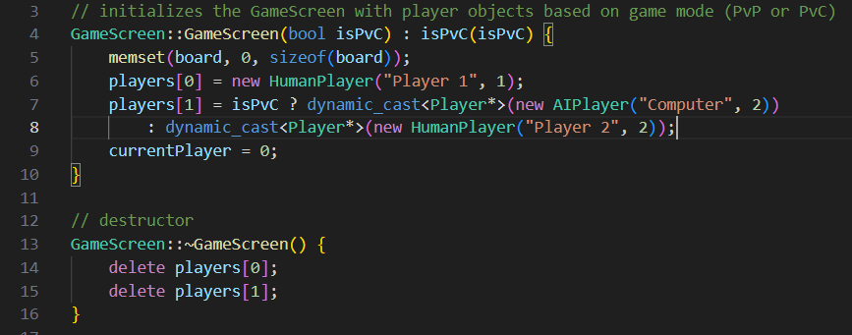
Composition
In GameScreen.cpp
The 2 players defined are parts of GameScrren

Slide 13
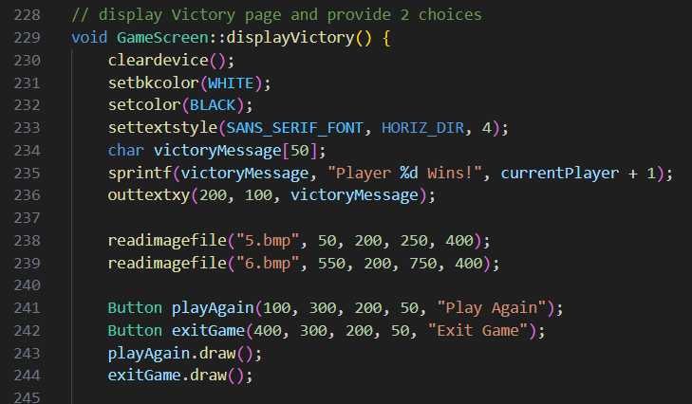
Aggregation
These objects are temporarily used and not tied to the lifecycle of others.
GameScreen have buttons
In GameScreen.cpp

Slide 14
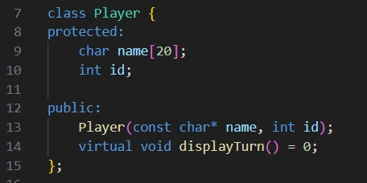
Inheritance
Parent

Slide 15
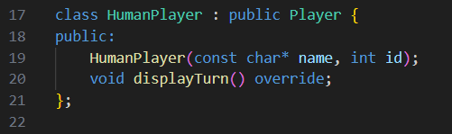
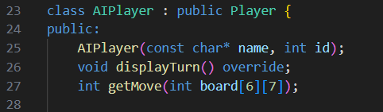
Inheritance
Child

Slide 16
Polymorphism
Virtual Function displayTurn in base class

Slide 17
Polymorphism
Virtual Function displayTurn in derived classes

Slide 18
RUN demonstration

Slide 19
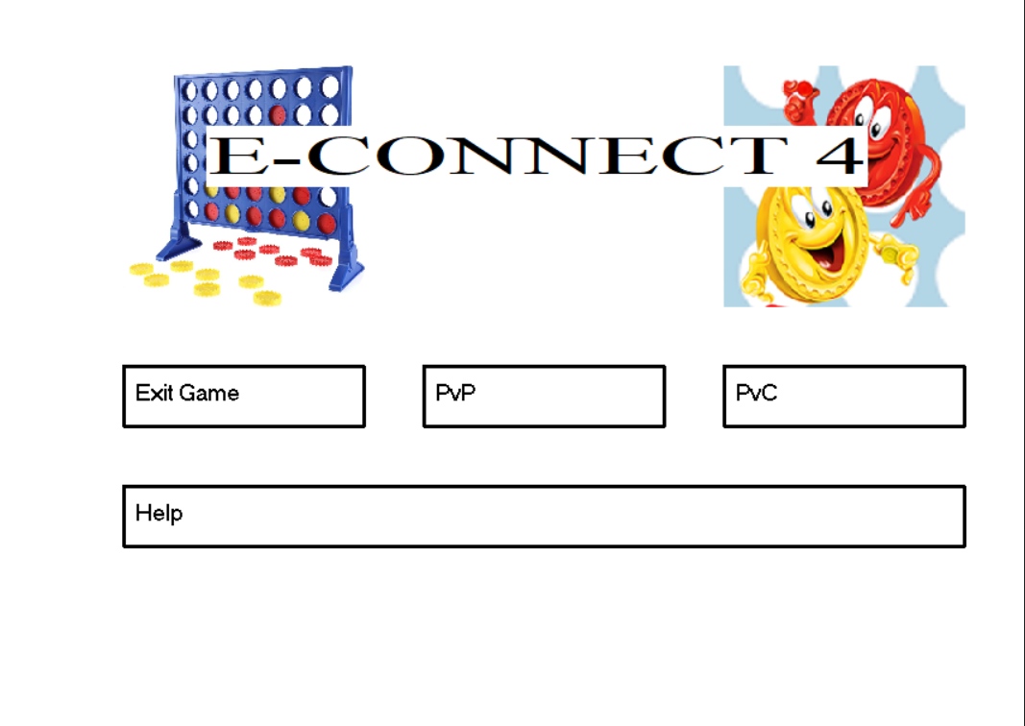
Main menu

Slide 20
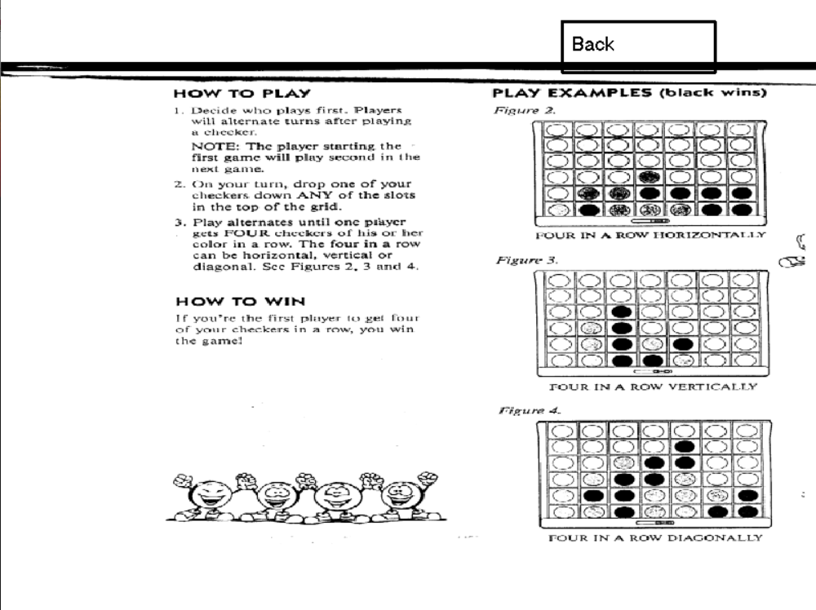
Help

Slide 21
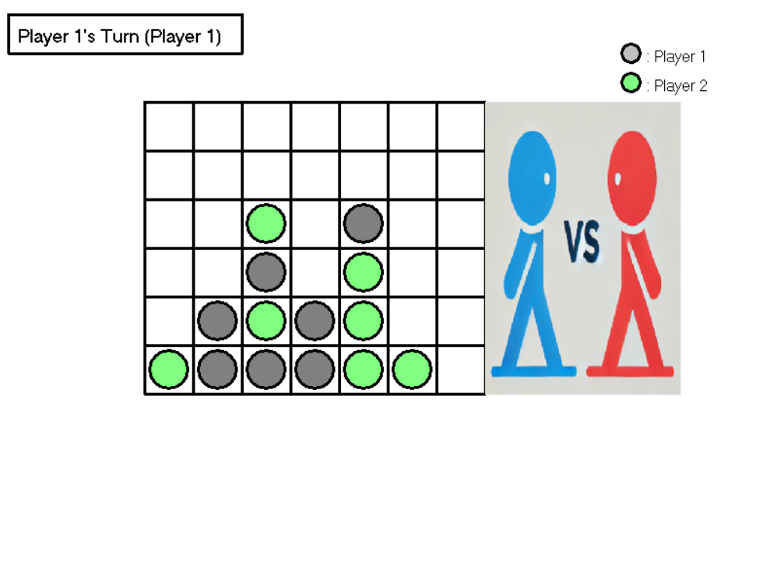
Gamescreen(PvP)-Player 1’s Turn

Slide 22
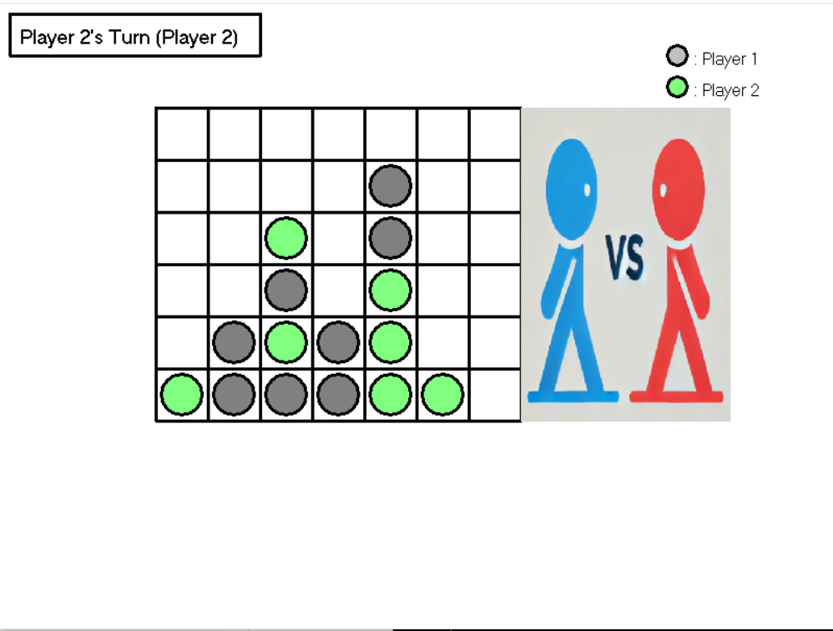
Gamescreen(PvP)-Player 2’s Turn

Slide 23
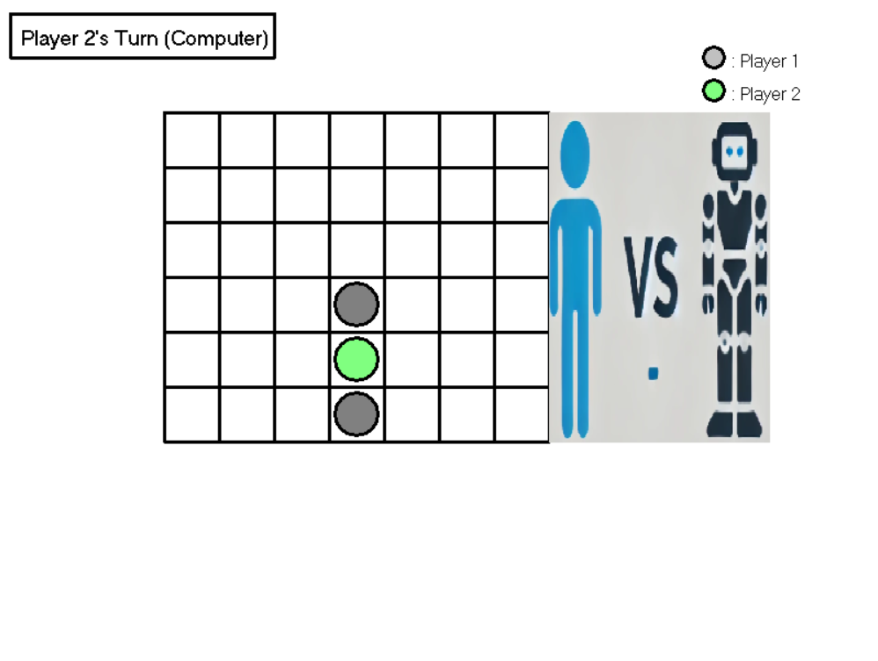
Gamescreen(PvC)-Player 2’s Turn

Slide 24
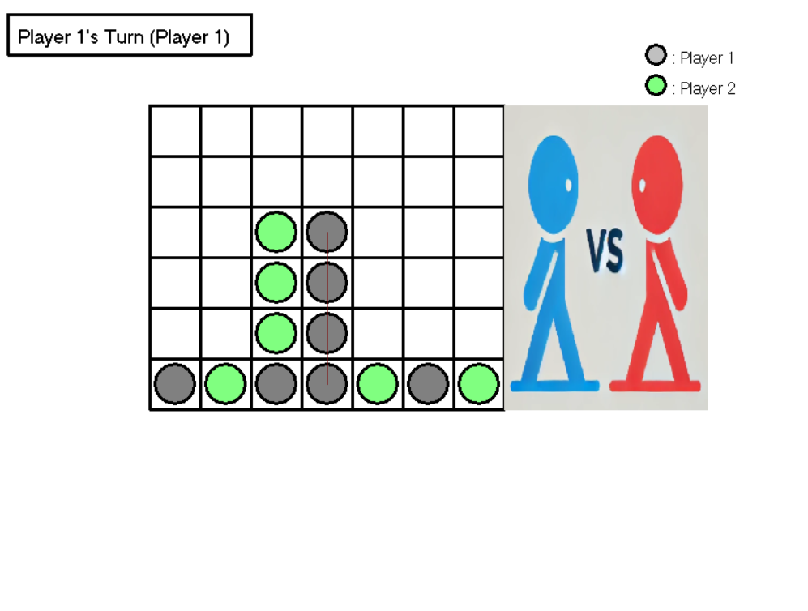
Gamescreen-Player 1 wins

Slide 25
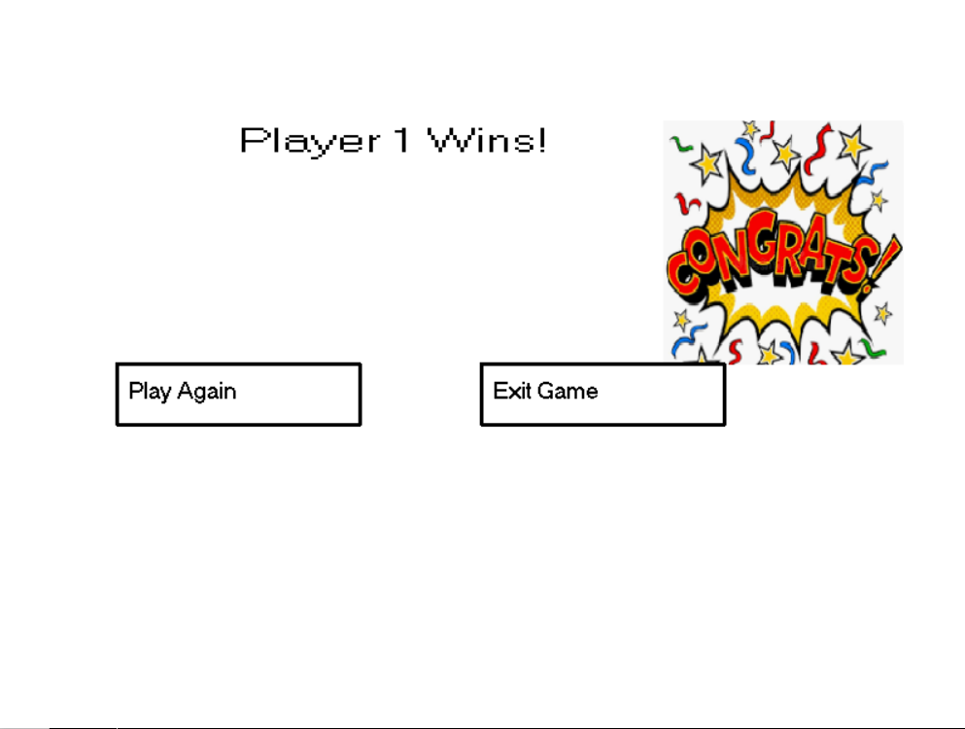
Displayvictory-player 1 wins

Slide 26
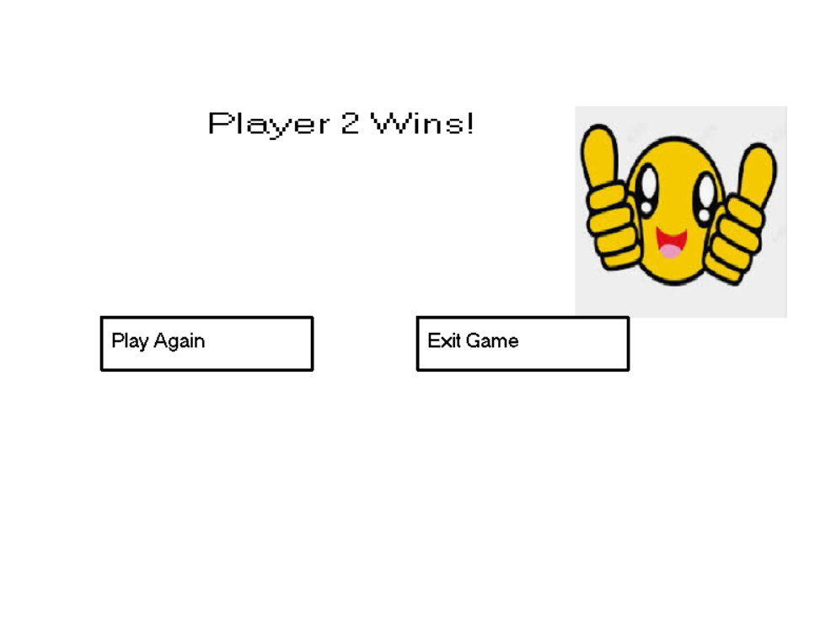
Displayvictory-player 2 wins

Slide 27

THANK you for listening!

